Slide 1
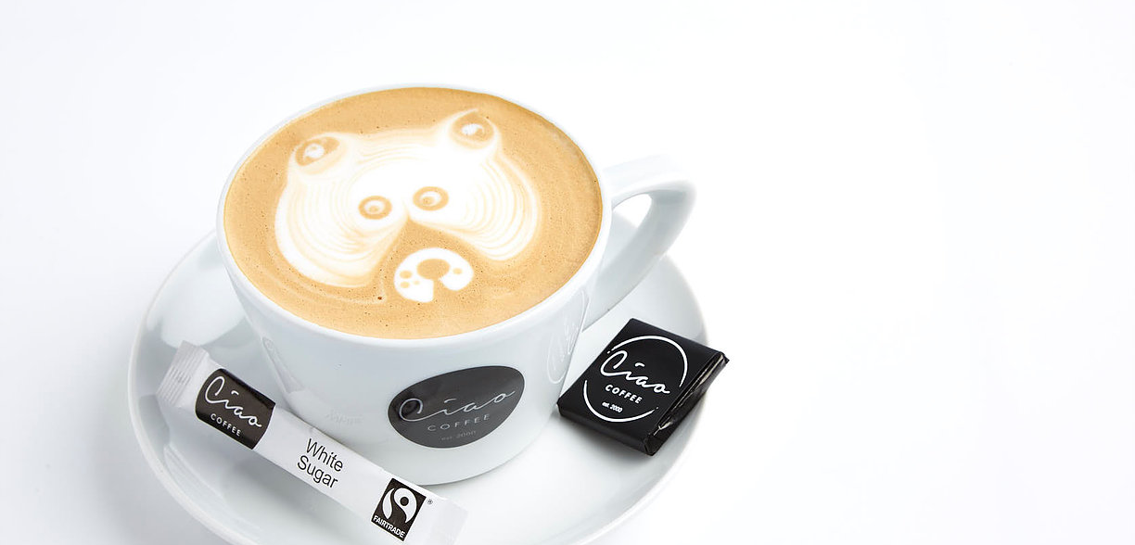
Ciao Coffee
Presented By-
James Joy
Shallu Rana
Jessy Felix
Sandeep Kaur
Pinu Raja
Kevin

Slide 2

Notes:
For this sprint James was the scrum master. As per the instructions in for this sprint it was decided by the product owner to develop a website that enables customers to order coffees. As the first step to build a website we had to produce an ER diagrams for the coffee cart which would help us build an Access database system. The major problem that we face during our first sprint was that each individual would do their part and in the end we would have a difficult time in merging our work together wasting unnecessary hours. To avoid this situation we decided to use GitHub. Even though we as a team are not familiar with GitHub and its advantages we decided to take this great leap of faith . Better fail and know you have tried , than to regret knowing you’ve never tried at all.

Slide 3
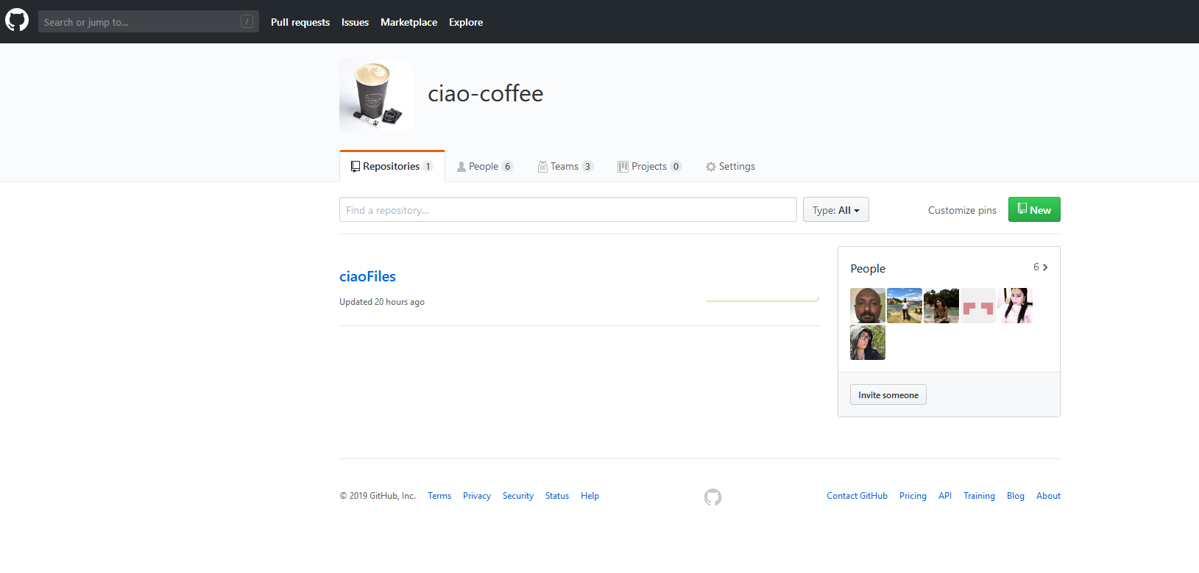
GITHUB Organisation – Ciao Coffee
Notes:
GitHub makes it easier to collaborate with peers and look back at previous versions of our work. For our coffee cart we created an organization in GitHub called Ciao-Coffee. Then added all our team members in this organization . We have learned from online tutorials and different websites that GitHub keeps track of the all the changes we make to our files and the service is able to do this by using git, a revision control system that runs in the command line interface.

Slide 4
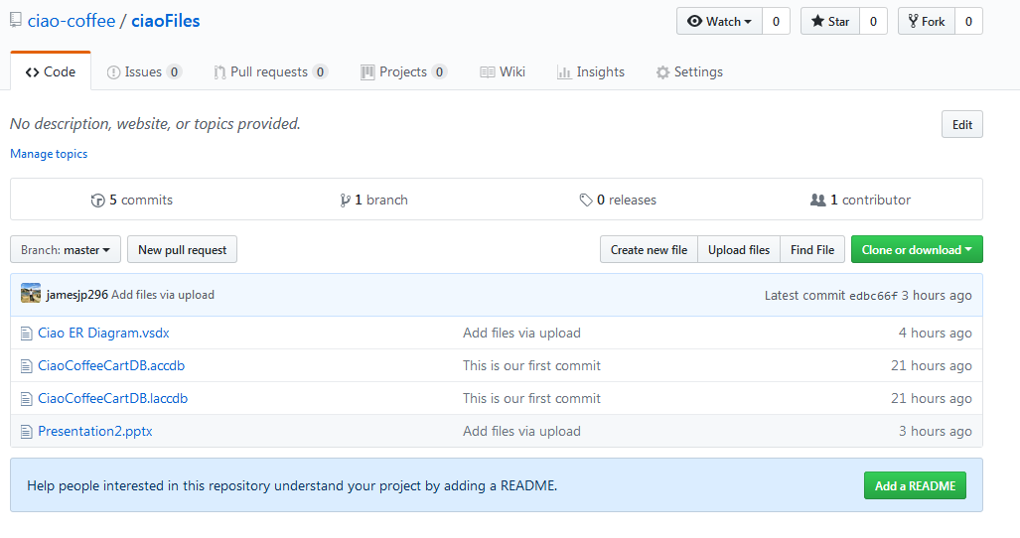
Manage Files
Notes:
We created a repository which allows us to share files and version control our documents .So we shared our files on GitHub online and created a local repository in our personal computers using GitBash and Git Desktop version .With the help of GitBash and Git desktop version we don’t have to always go online to add and commit our files which was very convenient as it just like make any changes to your file in your local computer.

Slide 5
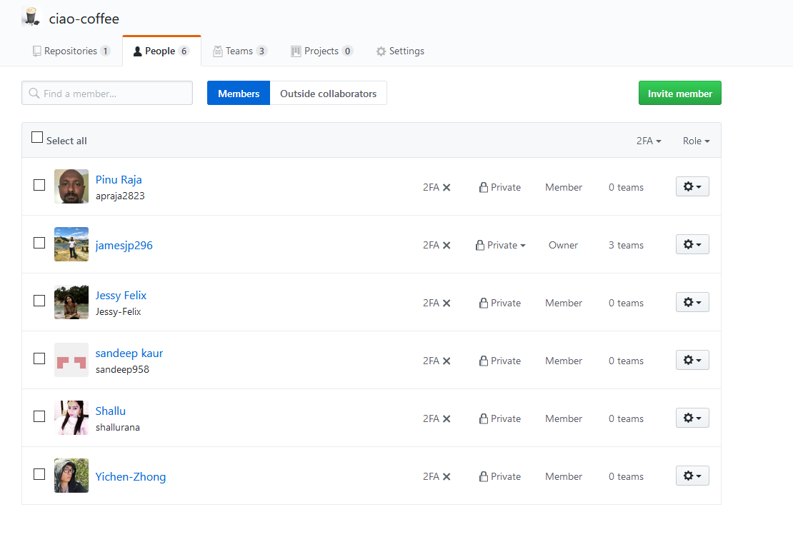
Team Members
Notes:
This shows the list of our team members in the organisation that we create “Ciao-Coffee”

Slide 6
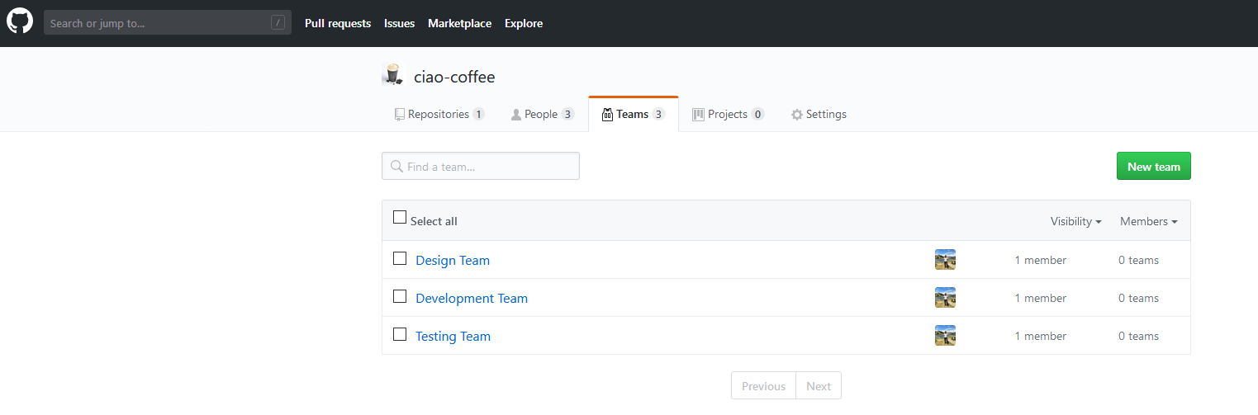
Teams in the Project
Notes:
This slide show the various teams that can be created in our organisation , Git gives us the ability to control the privileges each team has rather than setting the privileges for each individual member in the organisation show in the previous slide. We our still in the process of exploring how we can use this feature in the future of our product development. The next slide will be presented by Kevin who will discuss the UML use case diagram, the component diagram and the sequence diagram. Following which Shallu will explain the entities and the reason for using these entities and she will also explain each attributes and how they will help us track user information. Then Pinu will explain the ER diagram for the project which will help us build the Access database tables.The access database tables will be explained Jessy , she will give us the details of each table that is created in Access database. The presentation will be concluded by Sandeep who show our testing process and the flow of the tables when the data is added to the table.

Slide 7
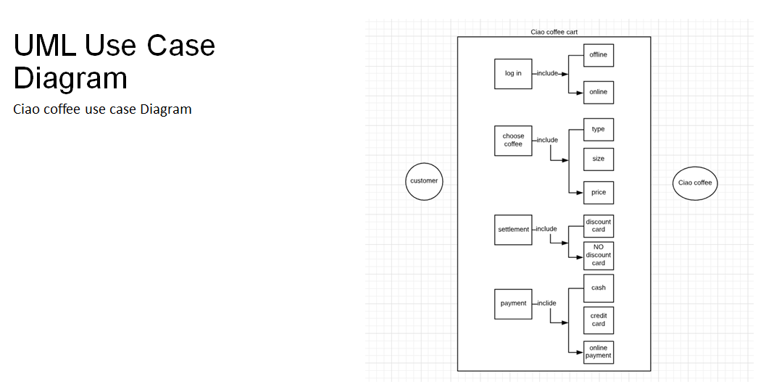
UML Diagram
Notes:
The UML use case diagram is explained by Kevin . We have the customer to left and ciao-coffee to the left , the customer first logs in to our system we have tried to use both online and sms facilities by which the customer can order the coffee . The customer that selects the type of coffee he/she needs the type of coffee, the size and the price. The customer than has the choice be our loyal customer and use the loyalty card which will allow the customer to get a free 10th coffee.And in the final step the customer makes the payment through the different payment options available that is cash , credit card or online payment.

Slide 8
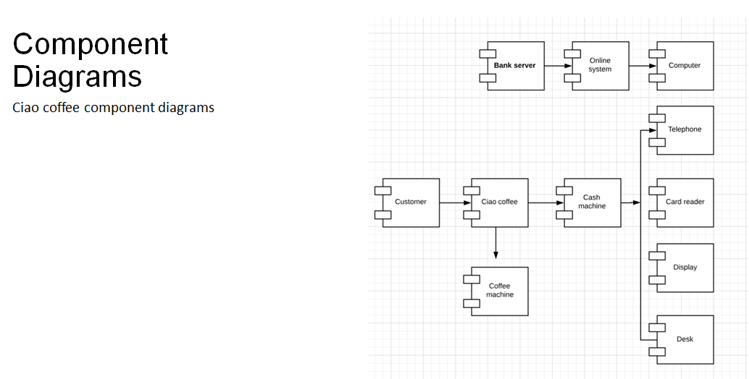
Component Diagram
Notes:
This is the component diagram which shows the different components in our system. The various components that are present in our system are the customer,the card reader,the online system and the bank server.

Slide 9
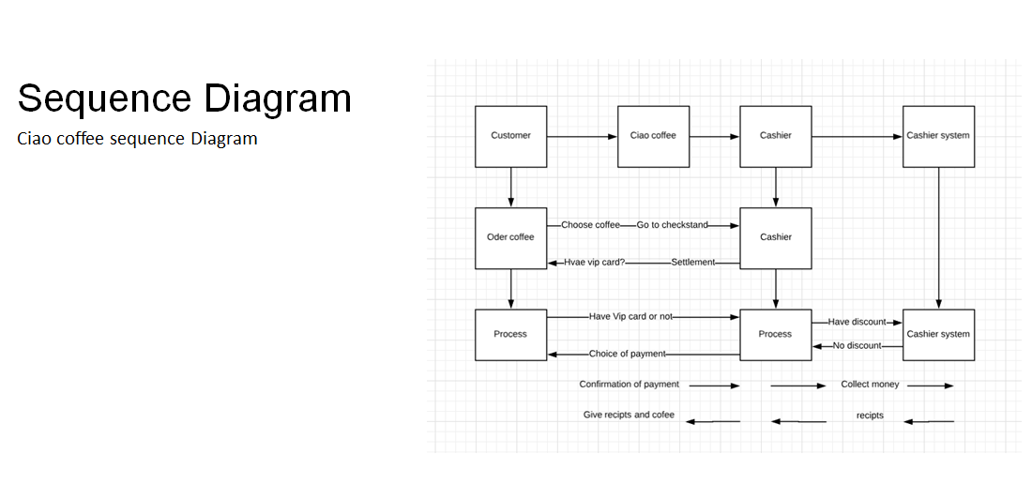
Sequence Diagram
Notes:
This is the sequence diagram of our coffee cart though we did not follow the standard format of the sequence diagram we made an effort to show the sequence of events that will take place in the coffee cart.The customer first logs in to the coffee cart the we show the customer the available types of coffee.The customer makes his/her selection coffee and the customer makes the payment using the different payment options that is available in the system.

Slide 10
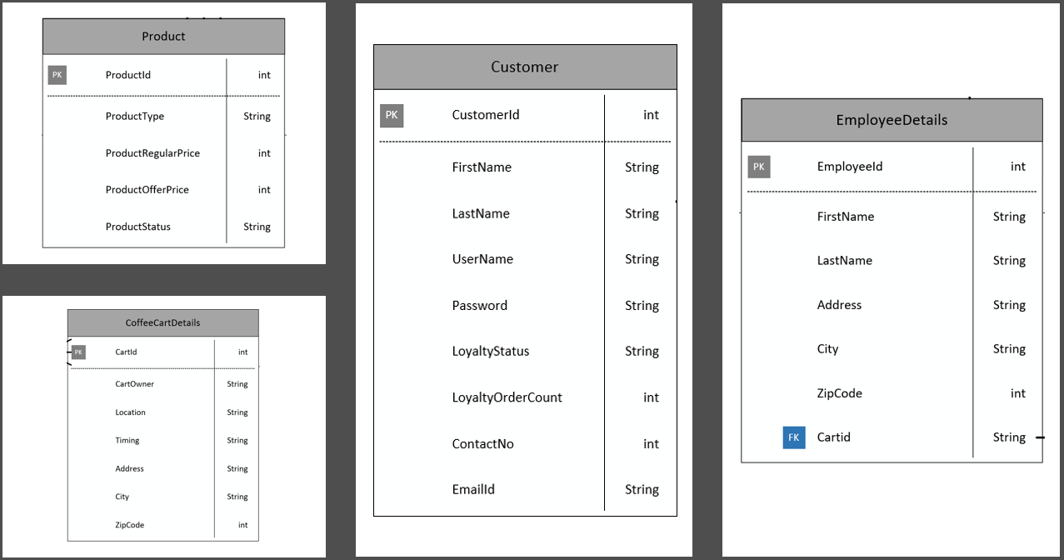
Master Entities
Notes:
This part is explained by Shallu. The slide shows the four master entities that we have identified for our coffee cart . The customer being the most important entity then the coffee cart entity from which the customer wants to by the coffee. The Employee Details entity represents the employees working in the coffee cart and finally the product entity. The product entity has the attributes that we think that the which will cover all the products and not just coffee. The product entity has the product id ,the product type and at the later stage we realised we should include the product name which is not included in the slide.However ,moving forward the product regular price and the product offer price. The product status attribute shows the customer if the product is available in a particular cart or not.The customer entity shows the attributes of like customerid, customer name ,customer username and password, contact details ,his loyalty status and the order count.The coffee cart entity has the details like cartid , cart owner name , cart location and timings , the address details and finally the employee details has the Employee id ,employee name and address details.

Slide 11
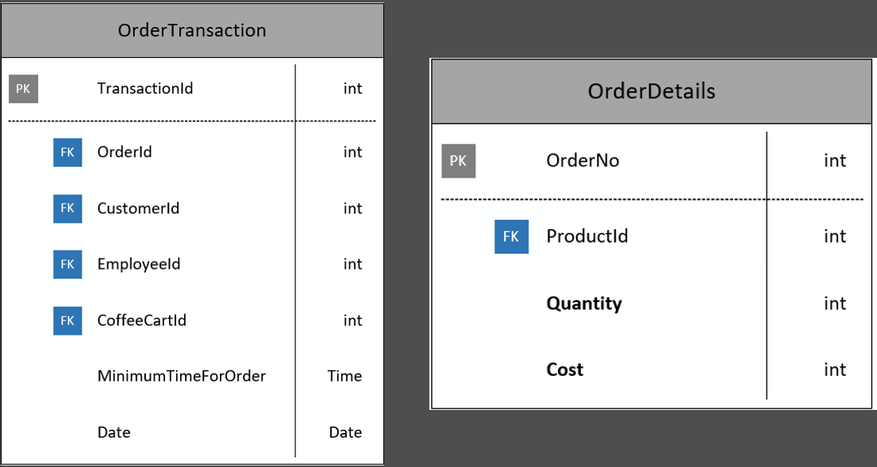
Transactional Entities
Notes:
This is the orderTransation details entity and the orderDetails entity which will capture the order details like the orderNo. , the productid , the quantity and the cost. In the class when Christopher explained about the order details to the other group we realised that the orderDetails should also have a foreign key for the transationId which will allow the users to place orders for multiple products in one transaction.The transaction entity has the transationId ,the orderId,the customerId, the employeeId , the coffeeCartId , the minimumTimeForOrder which gives the customer an approximate wait time for the coffee and the date of transation.

Slide 12
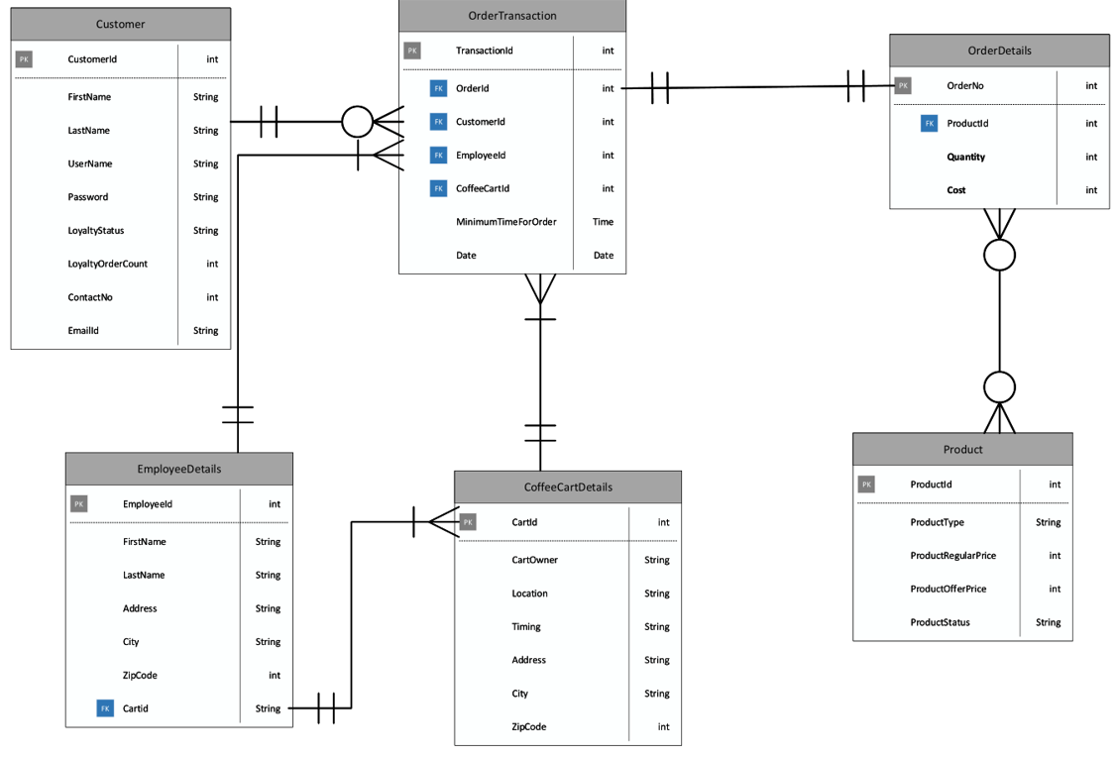
CIAO ER Diagram
Notes:
This slide is explained by Pinu. The is the Entity relationship diagram which attempts to show the relationship between each entity.The orderTransation has a one to one relationship with customer as there can only be one customer per transaction.However, a customer can have zero or many orderTransation,.The coffee cart and the employees entity share the same relationship with the order transaction as the customer that each order transaction can have one to one relationship with the Employees and the coffee cart whereas the employees and the coffee cart can have one or more orderTransaction. This should be the same with the orderDetails entity which was corrected for us by Christopher as there can be many orders in one transaction.So the relationship should be one to one and one to many between the orderTransaction and the orderDetails entities. And there is also a mistake between the relationship between orderDetails and the Product which was corrected by Christopher as there has to be one or many product in every order instead of zero to many relationship.

Slide 13
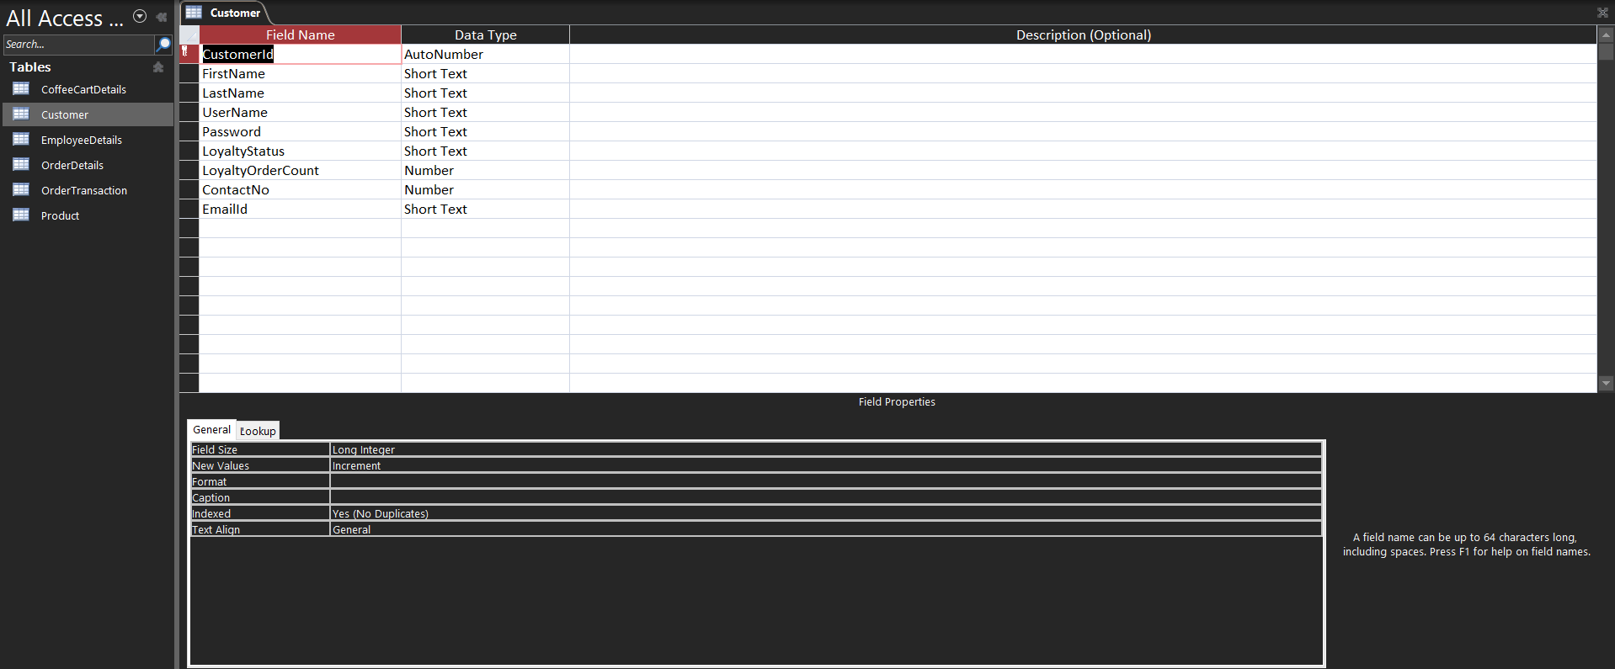
Customer Table
Notes:
This slide is explained by Jessy . This slide shows the customer table which has the same field as show in the customer entities slide with the help of which we created a table in the access database.

Slide 14
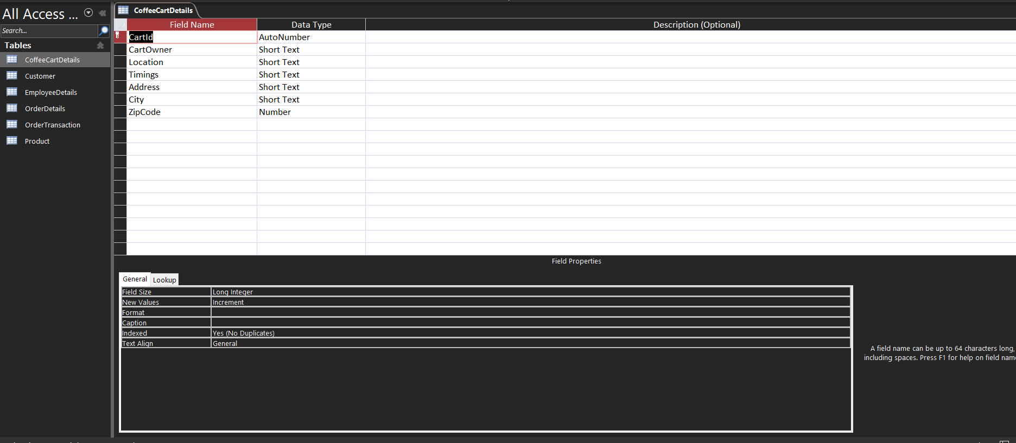
Ciao Coffee Cart Details Table
Notes:
The coffee cart table show the details of the coffee cart like the coffee cart owner, the coffee cart location , the address and timings.

Slide 15
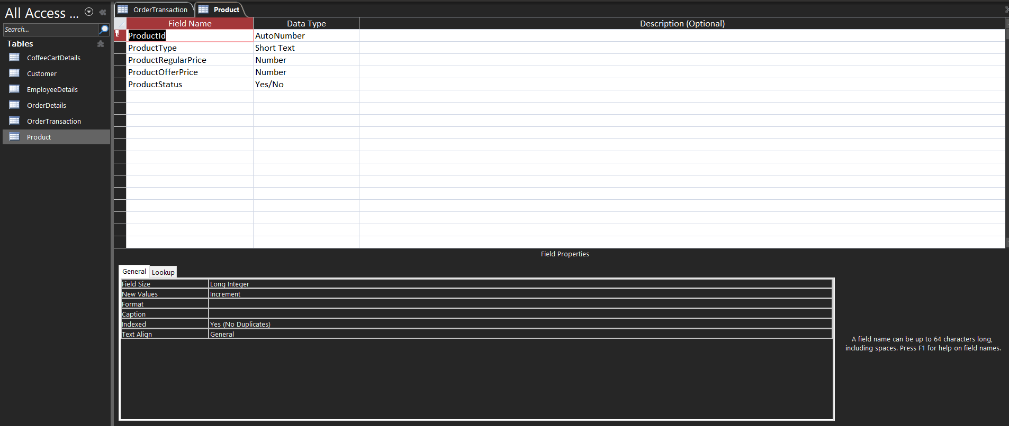
Product Table
Notes:
The Product Table show the details of the product the which are the productid ,the product type we later on realised the we also need the field called the product name to identify which product is bought by the customer ,and the product regular and offer price and the product status which is a yes/no option which tells the user if the product is available or not.

Slide 16

Employee Table
Notes:
This is the employees table which can store all the details we think will be required by an employer like the employee details ,the employee name and the employee address details .

Slide 17
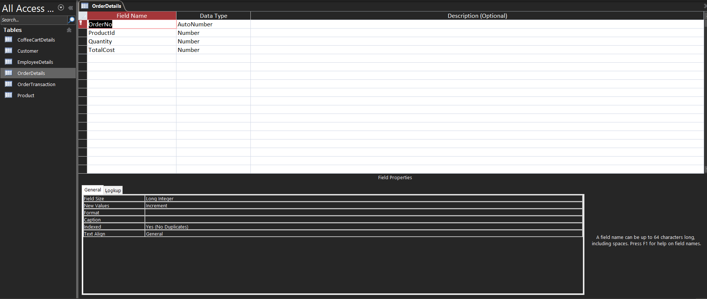
Order Details Table
Notes:
The order details table show the details of the order we decided to add the transaction id field to this table to help us identify which transaction this order belongs to, this table shows the product the customer wants ,the quantity and the total cost.

Slide 18

Transaction Table
Notes:
This is the transaction table that shows the complete information of the transaction this table has a lot of foreign keys like the orderNo from the orderDetails table , the product id from the products table , the employee id from the employees table , the cart id from the cartDetails table and the minTimeForOrder and the orderDate.

Slide 19
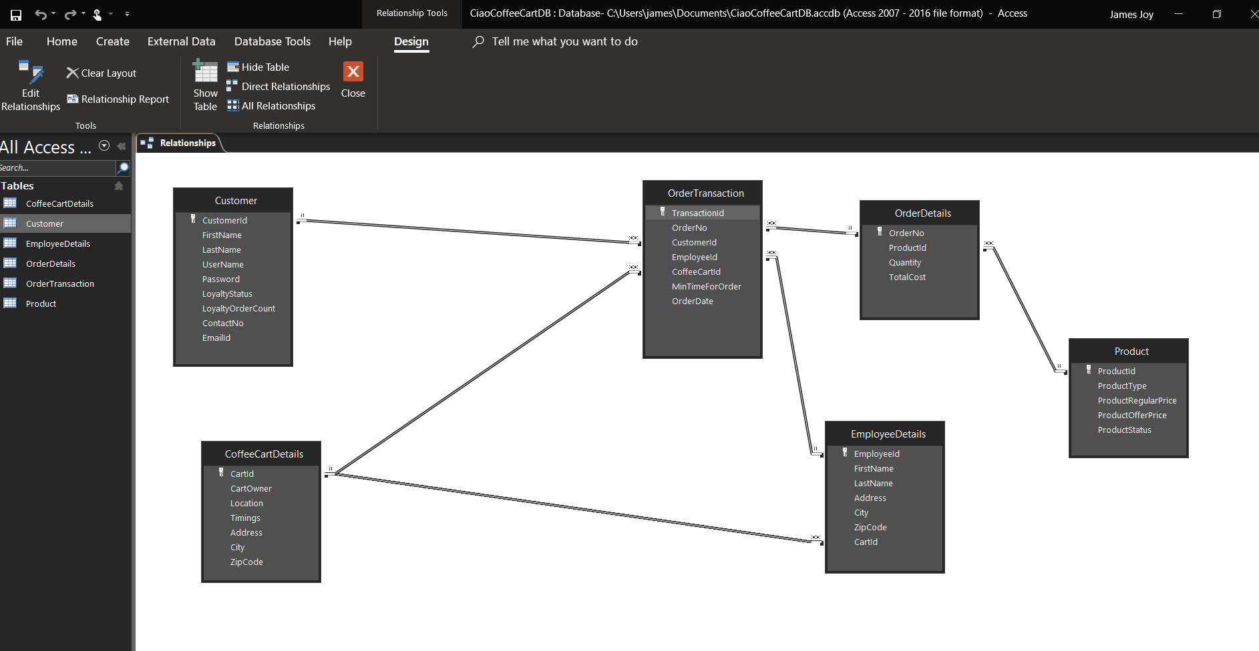
Access Relationship Diagram
Notes:
This is slide show the relationship between each table in the Access database we tried to achieve everything that we covered in the entity relationship diagram .The orderTransaction table has becomes the main table which fetches the data from all the master table to give the customer the final receipt.

Slide 20
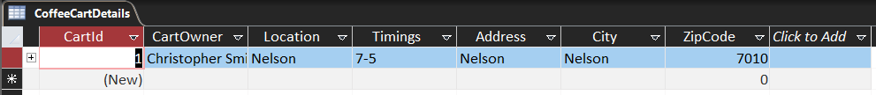
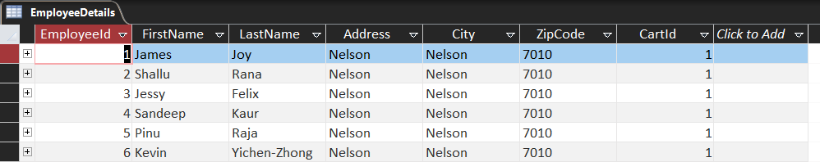
Access Tables
Coffee Cart Details
Employee Details
Notes:
This slide is explained by Sandeep. After creating the table we decide to test our system by adding data into it we decided to first add data to the master tables in order to avoid the issues caused by adding incorrect values to the foreign keys. We start with the coffee cart details table and add an entry of our product owners name that is Christopher Smith as the Cart owner and added the address and timing details of the cart. The we went on to add our team members name in the employee details table.

Slide 21
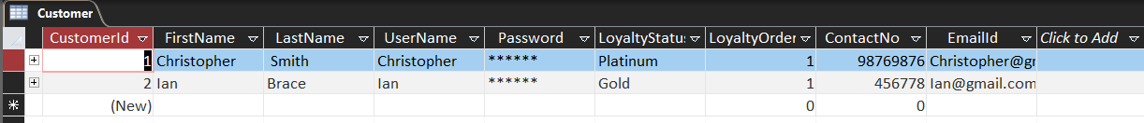
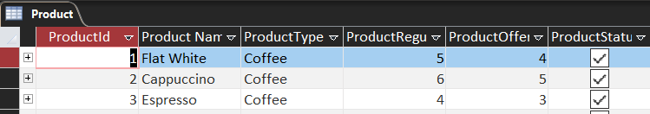
Access Tables
Customer Details
Product Details
Notes:
We then added the details of our first customers in the customer details table and the details of the products available in the coffee cart.

Slide 22
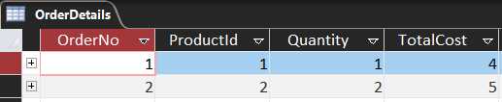
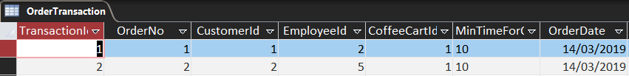
Access Tables
Order Details
Transaction Details
Notes:
Finally we placed an order in the orderDetails table and in the OrderTransaction Table which show the details orderid , the customerid , the employeeid , the coffeecartid and the minTimeForOrder and the orderDate.

Slide 23
Thank You

Slide 24
References
GitHub. (n.d.). In Wikipedia. Retrieved from https://en.wikipedia.org/wiki/GitHub
Novoseltseva, E. (2017).Benefits of using Github. Retrieved from https://apiumhub.com/tech-blog-barcelona/using-github/
Laurence, B. (2019).What Is GitHub, and Why Should I Use It?. Retrieved from https://www.thebalancecareers.com/what-is-github-and-why-should-i-use-it-2071946
GitHub. (2016). Hello World. Retrieved from https://guides.github.com/activities/hello-world/
Microsoft. (2019). Create a Database Model (also known as Entity Relationship diagram). Retrieved from https://support.office.com/en-us/article/create-a-database-model-also-known-as-entity-relationship-diagram-7042e719-384a-4b41-b29c-d1b35719fc93
Quackit. (2019).Microsoft Access Tutorial. Retrieved from https://www.quackit.com/microsoft_access/tutorial/
DatabaseGuide. (2016).Microsoft Access Tutorial. Retrieved from https://database.guide/microsoft-access-tutorial/

